Slide 1
Notes:
‹#›

Slide 2
The Energy of Life
The living cell is a miniature chemical factory where thousands of reactions occur
Cellular respiration extracts energy stored in sugars and other fuels
Cells apply this energy to perform work
Some organisms even convert energy to light, as in bioluminescence

Slide 3
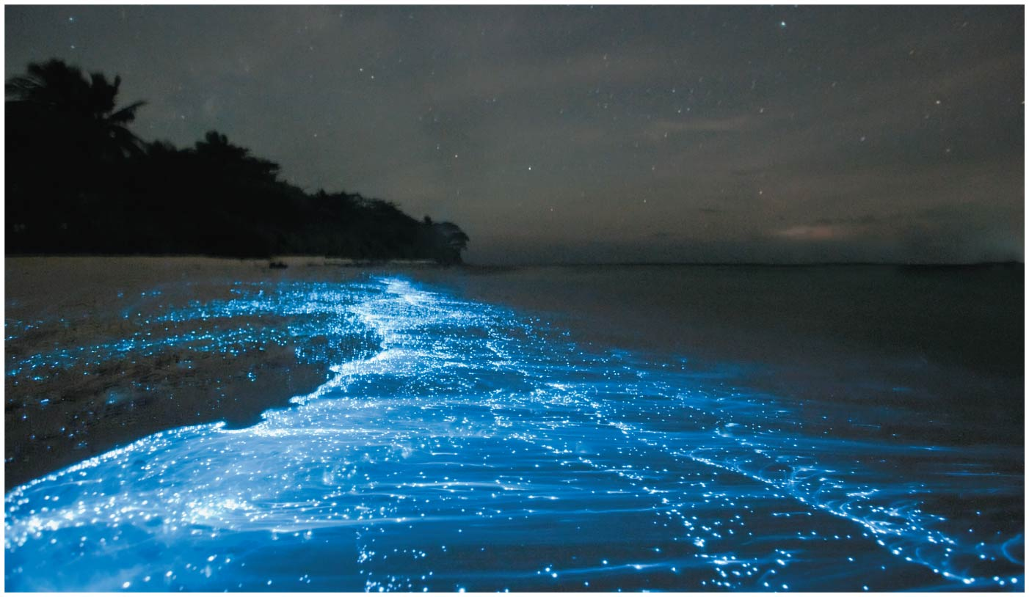
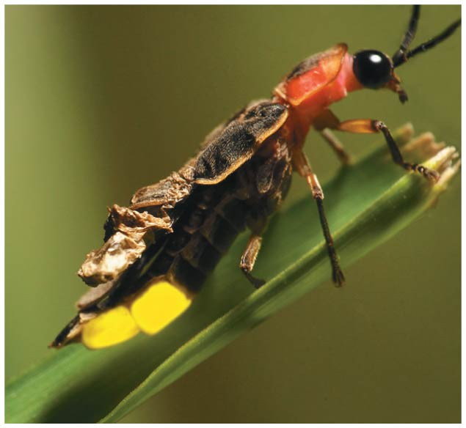
Figure 6.1
What causes these breaking waves to glow?
Firefly
© 2018 Pearson Education Ltd.
Notes:
Figure 6.1 What causes these breaking waves to glow?

Slide 4
Concept 6.1: An organism’s metabolism transforms matter and energy, subject to the laws of thermodynamics
Metabolism is the totality of an organism’s chemical reactions
Metabolism is an emergent property of life that arises from orderly interactions between molecules

Slide 5
Organization of the Chemistry of Life into Metabolic Pathways
A metabolic pathway代謝途徑begins with a specific molecule and ends with a product
Each step is catalyzed by a specific enzyme

Slide 6
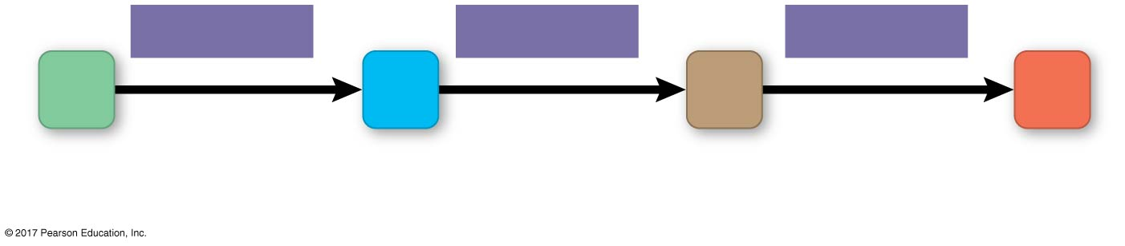
Figure 6.UN01
Generalized metabolic pathway
Enzyme 1
Enzyme 2
Enzyme 3
A
B
C
D
Reaction 1
Reaction 2
Reaction 3
Starting
molecule
Product
© 2018 Pearson Education Ltd.
Notes:
Figure 6.UN01 In-text figure, generalized metabolic pathway, p. 142

Slide 7
Catabolic pathways release energy by breaking down complex molecules into simpler compounds
Cellular respiration, the breakdown of glucose in the presence of oxygen, is an example of a pathway of catabolism

Slide 8
Anabolic pathways合成代謝consume energy to build complex molecules from simpler ones
For example, the synthesis of protein from amino acids is an anabolic pathway
Bioenergetics is the study of how energy flows through living organisms

Slide 9
Forms of Energy
Energy is the capacity to cause change
Energy exists in various forms, some of which can perform work

Slide 10
Kinetic energy is energy associated with motion
Thermal energy is the kinetic energy associated with random movement of atoms or molecules
Heat is thermal energy in transfer between objects
Potential energy is energy that matter possesses because of its location or structure
Chemical energy is potential energy available for release in a chemical reaction
Energy can be converted from one form to another

Slide 11
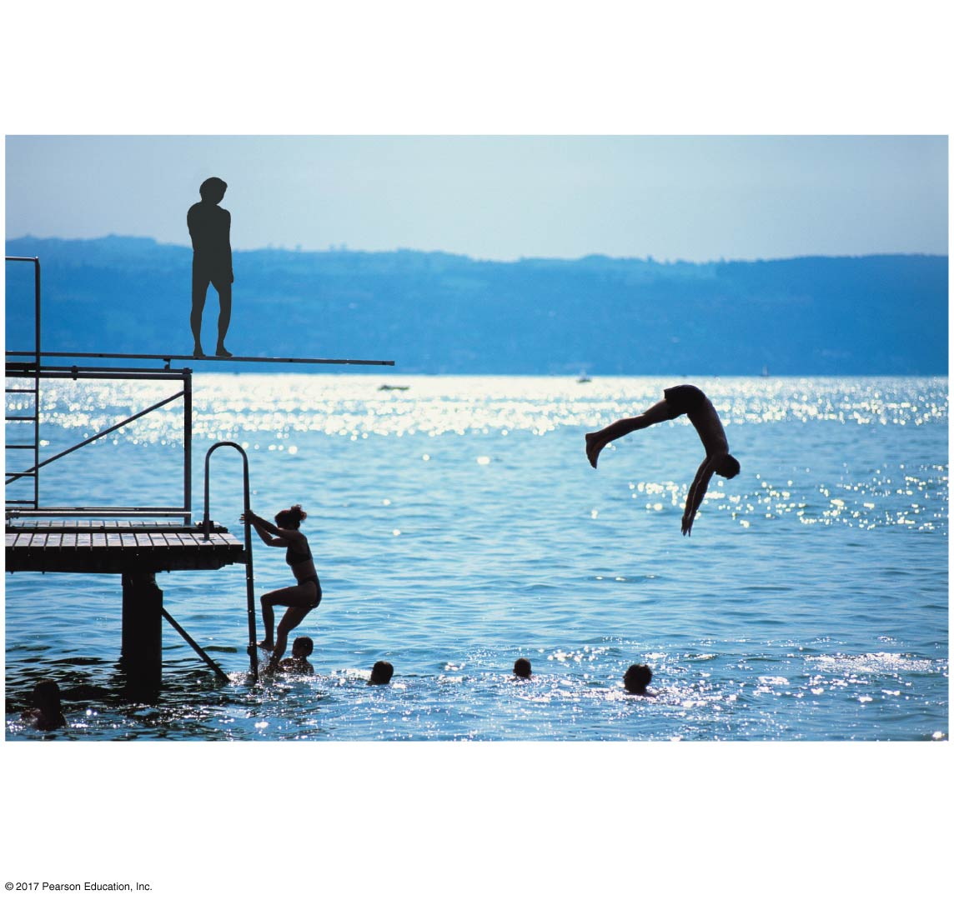
Figure 6.2
A diver has more potential
energy on the platform
than in the water.
Diving converts
potential energy to
kinetic energy.
Climbing up converts the kinetic
energy of muscle movement
to potential energy.
A diver has less potential
energy in the water
than on the platform.
© 2018 Pearson Education Ltd.
Notes:
Figure 6.2 Transformations between potential and kinetic energy

Slide 12
The Laws of Energy Transformation
Thermodynamics is the study of energy transformations
An isolated system, such as that approximated by liquid in a thermos, is unable to exchange energy or matter with its surroundings
In an open system, energy and matter can be transferred between the system and its surroundings
Organisms are open systems

Slide 13
The First Law of Thermodynamics
According to the first law of thermodynamics, the energy of the universe is constant
Energy can be transferred and transformed, but it cannot be created or destroyed
The first law is also called the principle of conservation of energy

Slide 14
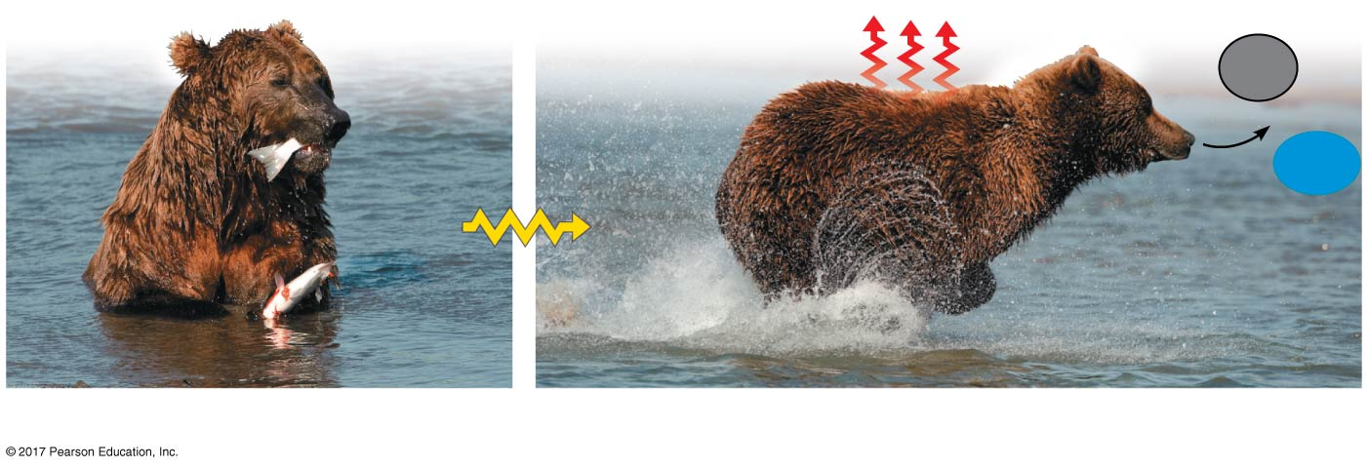
Figure 6.3
The two laws of thermodynamics
Heat
CO₂
+
Chemical
energy
in food
H₂O
Kinetic
energy
(a) First law of thermodynamics
(b) Second law of thermodynamics
© 2018 Pearson Education Ltd.
Notes:
Figure 6.3 The two laws of thermodynamics

Slide 15
The Second Law of Thermodynamics
During every energy transfer or transformation, some energy is unusable and is often lost as heat
According to the second law of thermodynamics,
Every energy transfer or transformation increases the entropy熵of the universe
Entropy is a measure of molecular disorder, or randomness

Slide 16
Living cells unavoidably convert organized forms of energy to heat, a more disordered form of energy
Spontaneous processes自發過程occur without energy input; they can happen quickly or slowly
For a process to occur spontaneously, it must increase the entropy of the universe
Processes that decrease entropy are nonspontaneous; they will occur only if energy is provided

Slide 17
Biological Order and Disorder
Organisms create ordered structures from less organized forms of energy and matter
Organisms also replace ordered forms of matter and energy in their surroundings with less ordered forms
For example, animals consume complex molecules in their food and release smaller, lower energy molecules and heat into the surroundings

Slide 18
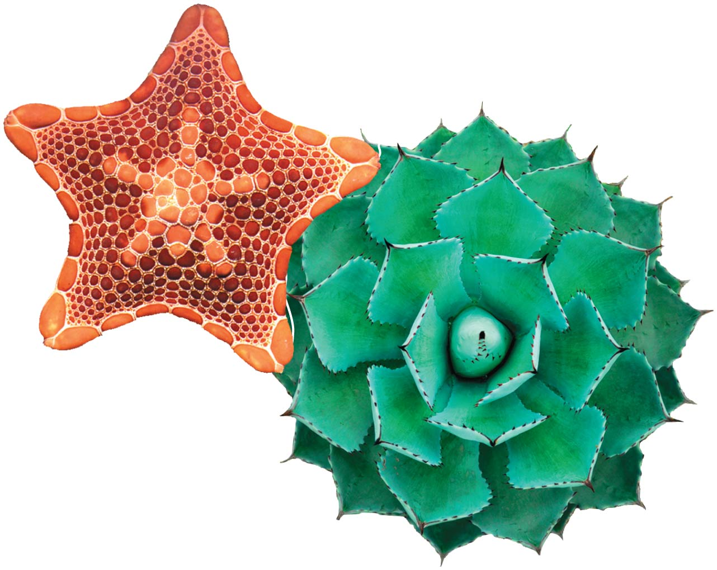
Figure 6.4
Order as a characteristic of life
© 2018 Pearson Education Ltd.
Notes:
Figure 6.4 Order as a characteristic of life

Slide 19
The evolution of more complex organisms does not violate the second law of thermodynamics
Entropy (disorder) may decrease in a particular system, such as an organism, as long as the total entropy of the system and surroundings increases

Slide 20
Concept 6.2: The free-energy change of a reaction tells us whether or not the reaction occurs spontaneously
Biologists want to know which reactions occur spontaneously and which require input of energy
To do so, they need to determine the energy and entropy changes that occur in chemical reactions

Slide 21
Free-Energy Change, ΔG
A living system’s free energy自由能is energy that can do work when temperature and pressure are uniform, as in a living cell

Slide 22
The change in free energy (ΔG) during a process is related to the change in enthalpy—change in total energy (ΔH)—change in entropy (ΔS), and temperature in Kelvin units (T)
ΔG = ΔH − TΔS (不考)
ΔG is negative for all spontaneous processes; processes with zero or positive ΔG are never spontaneous
Spontaneous processes can be harnessed to perform work

Slide 23
Free Energy, Stability, and Equilibrium
Free energy is a measure of a system’s instability, its tendency to change to a more stable state
During a spontaneous change, free energy decreases and the stability of a system increases
Equilibrium is a state of maximum stability
A process is spontaneous and can perform work only when it is moving toward equilibrium

Slide 24
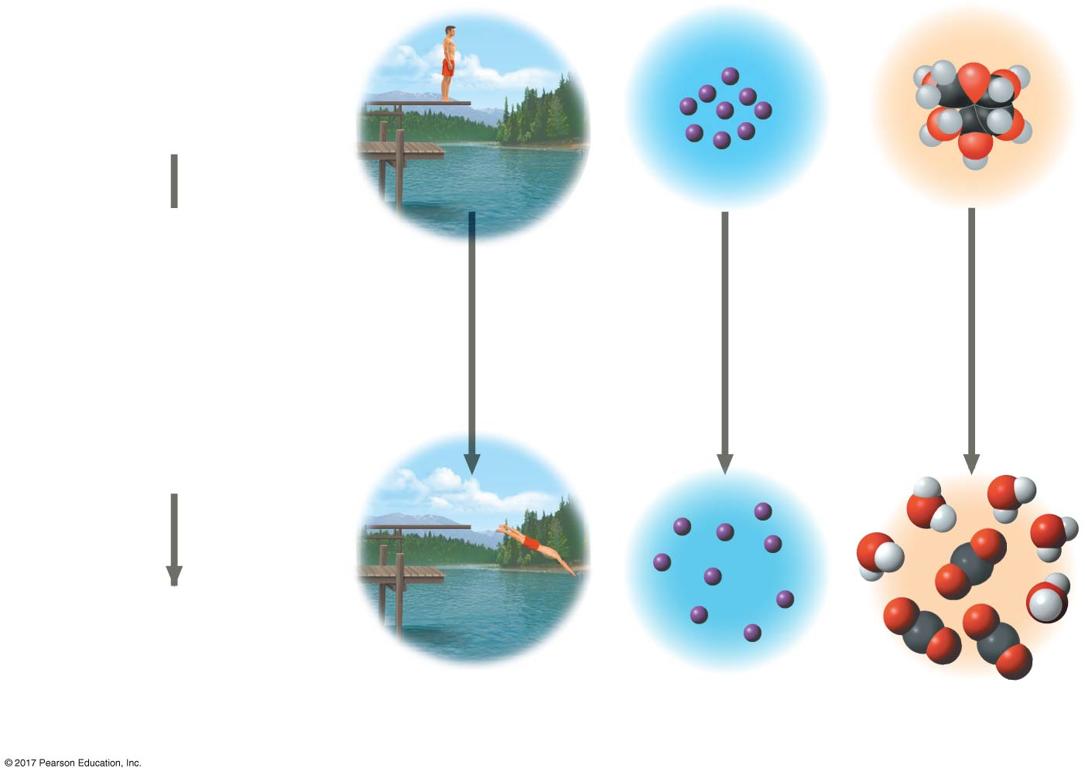
Figure 6.5
The relationship of free energy to stability, work capacity, and spontaneous change
More free energy (higher G)
Less stable
Greater work capacity
In a spontaneous change
The free energy of the system decreases (∆G < 0)
The system becomes more stable
The released free energy can be harnessed to do work
Less free energy (lower G)
More stable
Less work capacity
(a) Gravitational motion
(b) Diffusion
(c) Chemical reaction
© 2018 Pearson Education Ltd.
Notes:
Figure 6.5 The relationship of free energy to stability, work capacity, and spontaneous change

Slide 25
Free Energy and Metabolism
The concept of free energy can be applied to the chemistry of life’s processes

Slide 26
Exergonic and Endergonic Reactions in Metabolism
An exergonic reaction(放能的)proceeds with a net release of free energy and is spontaneous
An endergonic reaction(吸能的)absorbs free energy from its surroundings and is nonspontaneous

Slide 27
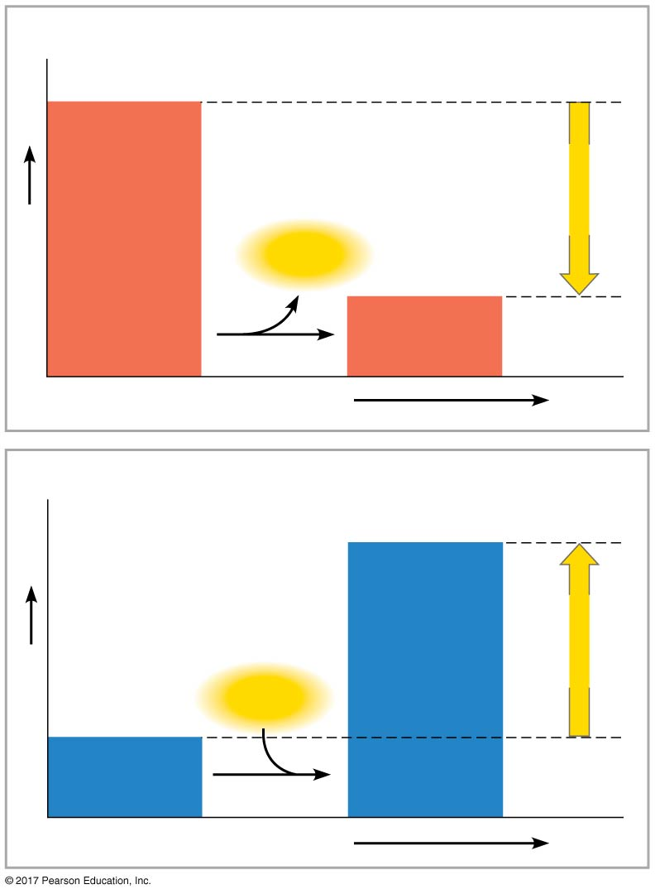
Figure 6.6
(a) Exergonic reaction: energy released, spontaneous
Reactants
Amount of
energy
released
(∆G < 0)
Free energy
Energy
Products
Progress of the reaction
(b) Endergonic reaction: energy required, nonspontaneous
Products
Amount of
energy
required
(∆G > 0)
Free energy
Energy
Reactants
Progress of the reaction
© 2018 Pearson Education Ltd.
Notes:
Figure 6.6 Free energy changes (ΔG) in exergonic and endergonic reactions

Slide 28
Equilibrium and Metabolism
Reactions in a closed system eventually reach equilibrium and can then do no work

Slide 29
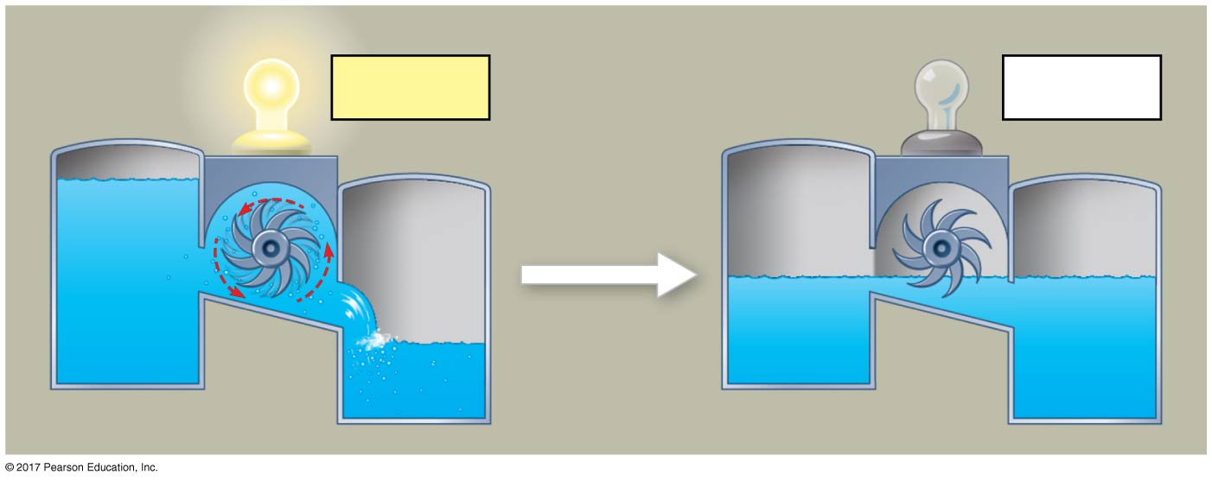
Figure 6.7
Equilibrium and work in an isolated hydroelectric system
∆G < 0
∆G = 0
© 2018 Pearson Education Ltd.
Notes:
Figure 6.7 Equilibrium and work in an isolated hydroelectric system

Slide 30
Cells are not in equilibrium; they are open systems experiencing a constant flow of materials
A defining feature of life is that metabolism is never at equilibrium
A catabolic pathway in a cell releases free energy in a series of reactions

Slide 31
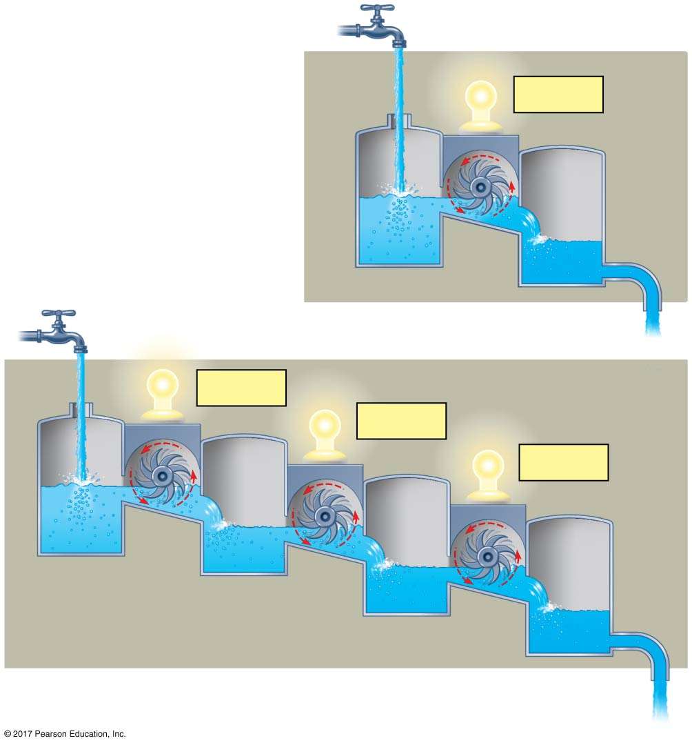
Figure 6.8
(a) An open hydroelectric system
∆G < 0
Equilibrium and work in open systems
∆G < 0
∆G < 0
∆G < 0
(b) A multistep open hydroelectric system
© 2018 Pearson Education Ltd.
Notes:
Figure 6.8 Equilibrium and work in open systems

Slide 32
Concept 6.3: ATP powers cellular work by coupling exergonic reactions to endergonic reactions
A cell does three main kinds of work:
Chemical work—pushing endergonic reactions
Transport work—pumping substances against the direction of spontaneous movement
Mechanical work—such as contraction of muscle cells

Slide 33
To do work, cells manage energy resources by energy coupling能量耦合, the use of an exergonic process to drive an endergonic one
Most energy coupling in cells is mediated by ATP

Slide 34
The Structure and Hydrolysis of ATP
ATP (adenosine triphosphate) is the cell’s energy shuttle
ATP is composed of ribose核糖(a sugar), adenine (a nitrogenous base), and three phosphate groups

Slide 35
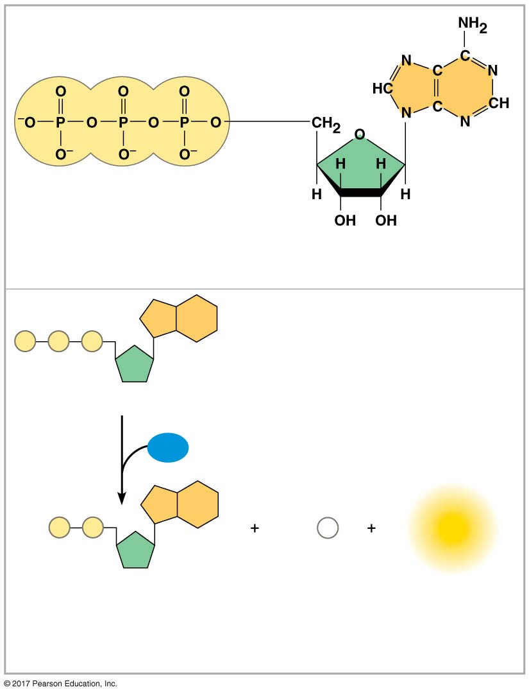
Figure 6.9
Adenine
Triphosphate group
(3 phosphate groups)
Ribose
(a) The structure of ATP
P
P
P
Adenosine triphosphate (ATP)
H₂O
P
P
P_{i}
Energy
Adenosine
diphosphate (ADP)
Inorganic
phosphate
(b) The hydrolysis of ATP
© 2018 Pearson Education Ltd.
Notes:
Figure 6.9 The structure and hydrolysis of adenosine triphosphate (ATP)

Slide 36
The bonds between the phosphate groups of ATP’s tail can be broken by hydrolysis
Energy is released from ATP when the terminal phosphate bond is broken
This release of energy comes from the chemical change to a state of lower free energy, not from the phosphate bonds themselves

Slide 37
How the Hydrolysis of ATP Performs Work
The three types of cellular work (mechanical, transport, and chemical) are powered by the hydrolysis of ATP
In the cell, the energy from the exergonic reaction of ATP hydrolysis can be used to drive an endergonic reaction
Overall, the coupled reactions are exergonic

Slide 38
ATP drives endergonic reactions by phosphorylation, transferring a phosphate group to some other molecule, such as a reactant
The recipient molecule is now called a phosphorylated intermediate磷酸化中間物

Slide 39
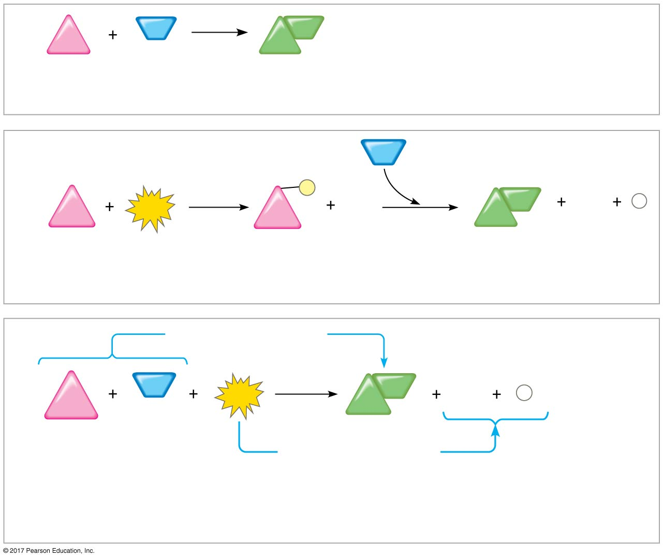
Figure 6.10
Energy coupling using ATP hydrolysis
NH₃
NH₂
∆G_{Glu} = +3.4 kcal/mol
Glu
Glu
Glutamic acid
Ammonia
Glutamine
(a) Glutamic acid conversion to glutamine (not spontaneous)
Less stable with
more free energy
NH₃
1
P
2
NH₂
ADP
ATP
ADP
P
i
Glu
Glu
Glu
Glutamic acid
Phosphorylated
intermediate
Glutamine
(b) Conversion reaction coupled with ATP hydrolysis (two steps)
∆G_{Glu} = +3.4 kcal/mol
NH₃
NH₂
ADP
P
Glu
ATP
Glu
i
∆G_{Glu} = +3.4 kcal/mol
∆G_{ATP} = –7.3 kcal/mol
+∆G_{ATP} = –7.3 kcal/mol
Net ∆G = –3.9 kcal/mol
© 2018 Pearson Education Ltd.
(c) Free-energy change for coupled reaction
Notes:
Figure 6.10 How ATP drives chemical work: Energy coupling using ATP hydrolysis

Slide 40
Transport and mechanical work in the cell are also powered by ATP hydrolysis
ATP hydrolysis leads to a change in protein shape and binding ability

Slide 41
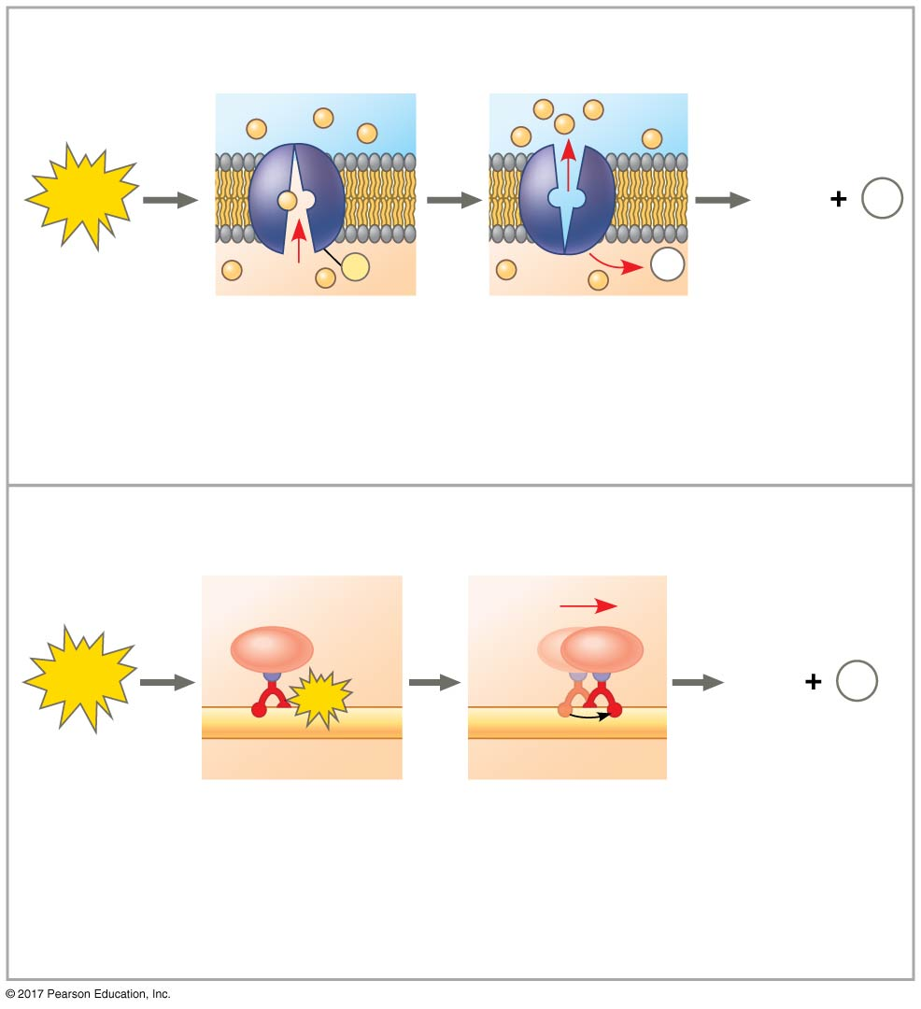
Figure 6.11
ATP drives transport and mechanical work
Transport protein
Solute (溶質)
ATP
ADP
P
i
P
P
_{i}
Solute
transported
(a) Transport work
Vesicle
Cytoskeletal track
ATP
ADP
Pi
ATP
Motor protein
Protein and
vesicle moved
(b) Mechanical work
© 2018 Pearson Education Ltd.
Notes:
Figure 6.11 How ATP drives transport and mechanical work

Slide 42
The Regeneration of ATP
ATP is a renewable resource that is regenerated by addition of a phosphate group to adenosine diphosphate (ADP)
The energy to phosphorylate ADP comes from catabolic reactions in the cell
The ATP cycle is a revolving door through which energy passes during its transfer from catabolic to anabolic pathways

Slide 43
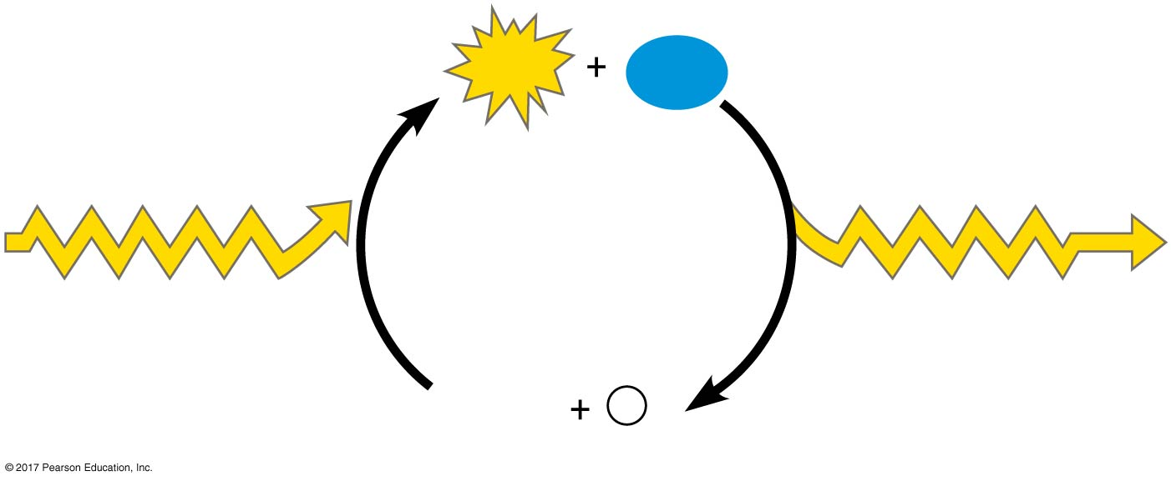
Figure 6.12
The ATP Cycle
ATP
H₂O
Energy from
catabolism (exergonic,
energy-releasing
processes)
Energy for cellular
work (endergonic,
energy-consuming
processes)
ADP
P
i
© 2018 Pearson Education Ltd.
Notes:
Figure 6.12 The ATP Cycle

Slide 44
Concept 6.4: Enzymes speed up metabolic reactions by lowering energy barriers
A catalyst (催化物) is a chemical agent that speeds up a reaction without being consumed by the reaction
An enzyme is a catalytic protein
For example, sucrase is an enzyme that catalyzes the hydrolysis of sucrose

Slide 45
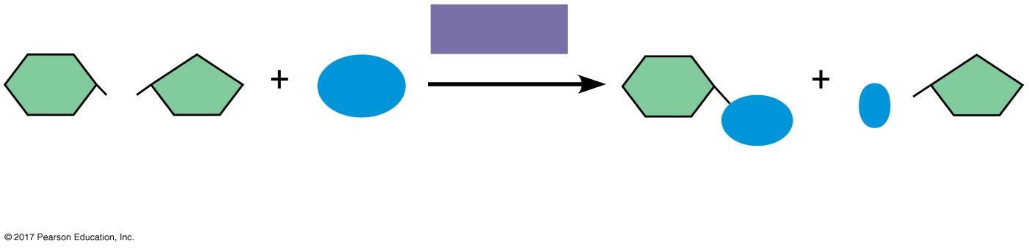
Figure 6.UN02
Sucrose hydrolysis
Sucrase
H₂O
O
HO
OH
Sucrose
(C₁₂H₂₂O₁₁)
Glucose
(C₆H₁₂O₆)
Fructose
(C₆H₁₂O₆)
© 2018 Pearson Education Ltd.
Notes:
Figure 6.UN02 In-text figure, sucrose hydrolysis, p. 151

Slide 46
The Activation Energy Barrier
Every chemical reaction between molecules involves bond breaking and bond forming
The initial energy needed to start a chemical reaction is called the free energy of activation, or activation energy (E_{A})
Activation energy is often supplied in the form of thermal energy that the reactant molecules absorb from their surroundings

Slide 47
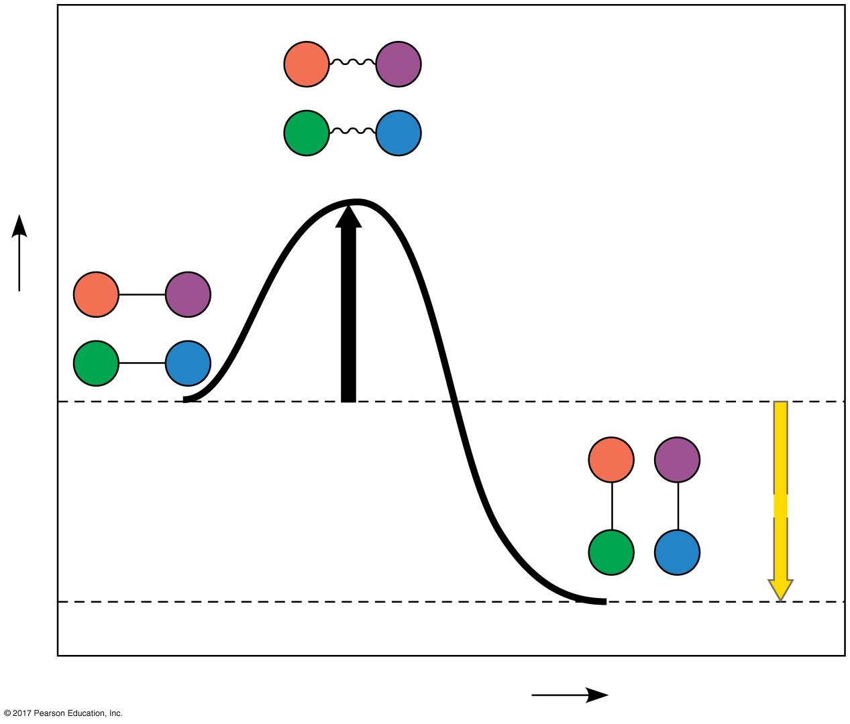
Figure 6.13
Energy profile of an exergonic reaction
A
B
C
D
Transition state
A
B
E_{A}
C
D
Free energy
Reactants
A
B
∆G < 0
C
D
Products
Progress of the reaction
© 2018 Pearson Education Ltd.
Notes:
Figure 6.13 Energy profile of an exergonic reaction

Slide 48
How Enzymes Speed Up Reactions
In catalysis, enzymes or other catalysts speed up specific reactions by lowering the E_{A} barrier
Enzymes do not affect the change in free energy (ΔG); instead, they hasten reactions that would occur eventually

Slide 49
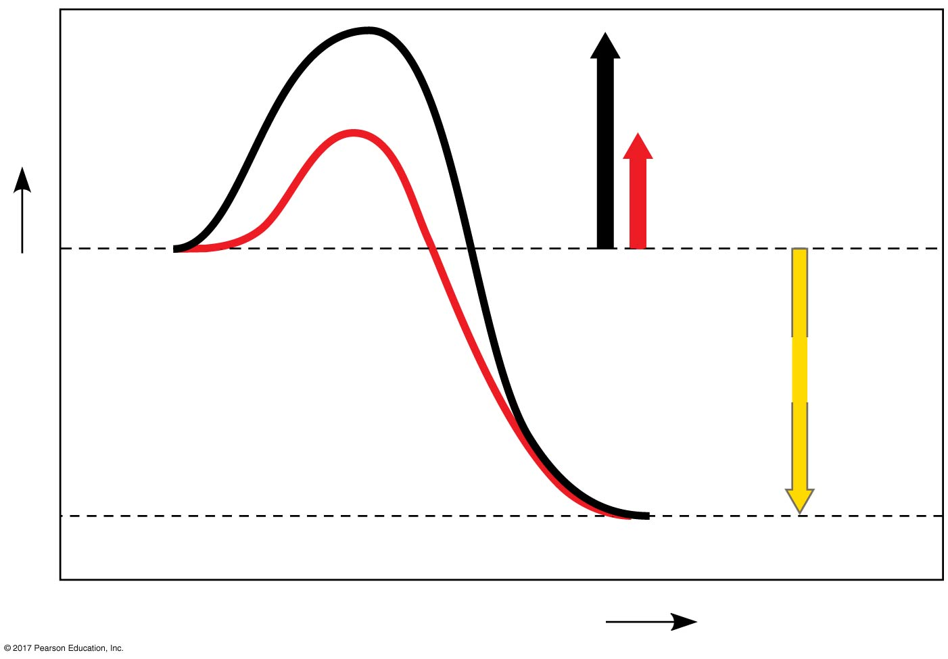
Figure 6.14
The effect of an enzyme on activation energy
Course of
reaction
without
enzyme
E_{A}
without
enzyme
E_{A} with
enzyme
is lower
Reactants
Free energy
Course of
reaction
with enzyme
∆G is unaffected
by enzyme
Products
Progress of the reaction
© 2018 Pearson Education Ltd.
Notes:
Figure 6.14 The effect of an enzyme on activation energy

Slide 50
Substrate Specificity of Enzymes
The reactant that an enzyme acts on is called the enzyme’s substrate (反應物稱爲底物)
The enzyme binds to its substrate, forming an enzyme-substrate complex
While bound, the activity of the enzyme converts substrate to product

Slide 51
The reaction catalyzed by each enzyme is very specific
The active site(活性位點)is the region on the enzyme where the substrate binds
Induced fit(誘導契合)of a substrate brings chemical groups of the active site into positions that enhance their ability to catalyze the reaction

Slide 52
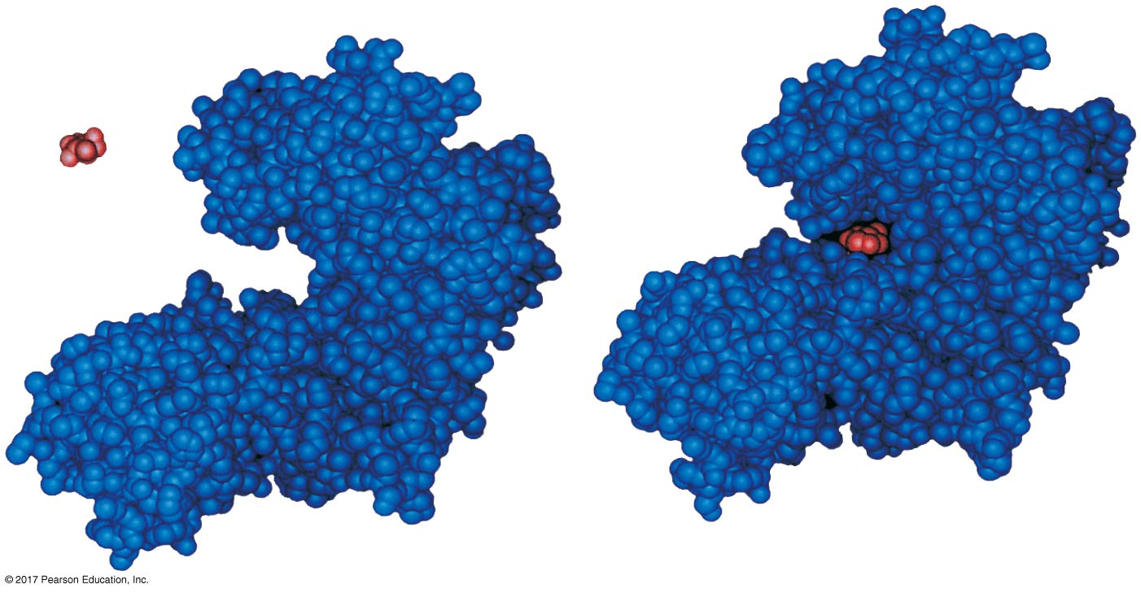
Figure 6.15
Induced fit between an enzyme and its substrate
Substrate
Active site
Enzyme-substrate
complex
Enzyme
© 2018 Pearson Education Ltd.
Notes:
Figure 6.15 Induced fit between an enzyme and its substrate

Slide 53
Catalysis in the Enzyme’s Active Site
In an enzymatic reaction, the substrate binds to the active site of the enzyme
Enzymes are extremely fast acting and emerge from reactions in their original form
Very small amounts of enzyme can have huge metabolic effects because they are used repeatedly in catalytic cycles

Slide 54
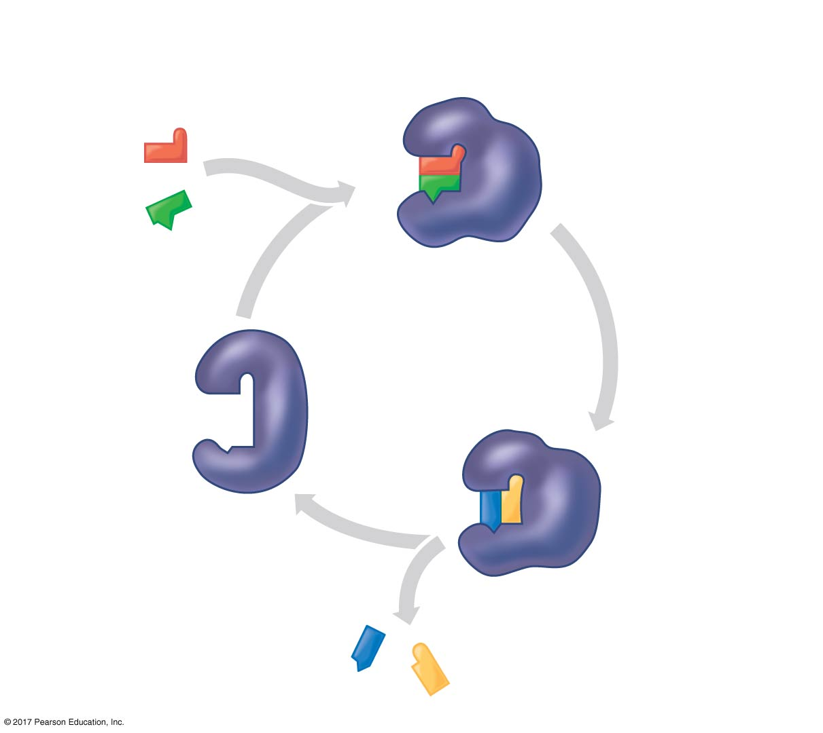
Figure 6.16_4
Substrates enter
active site.
Substrates are held
in active site by
weak interactions.
1
2
Substrates
Enzyme-substrate
complex
3
The active
site lowers
E_{A}.
6
Active site
is available
for new
substrates.
Enzyme
5
Products are
released.
4
Substrates are
converted to
products.
Products
© 2018 Pearson Education Ltd.
Notes:
Figure 6.16_4 The active site and catalytic cycle of an enzyme (step 4)

Slide 55
The active site can lower an E_{A} barrier by
orienting substrates correctly
straining substrate bonds
providing a favorable microenvironment
covalently bonding to the substrate

Slide 56
The rate of an enzyme-catalyzed reaction can be sped up by increasing substrate concentration
When all enzyme molecules have their active sites engaged, the enzyme is saturated
If the enzyme is saturated, the reaction rate can only be sped up by adding more enzyme

Slide 57
Effects of Local Conditions on Enzyme Activity
An enzyme’s activity can be affected by
general environmental factors, such as temperature and pH
chemicals that specifically influence the enzyme

Slide 58
Effects of Temperature and pH
Each enzyme has an optimal temperature in which it can function
Each enzyme has an optimal pH in which it can function
Optimal conditions favor the most active shape for the enzyme molecule

Slide 59
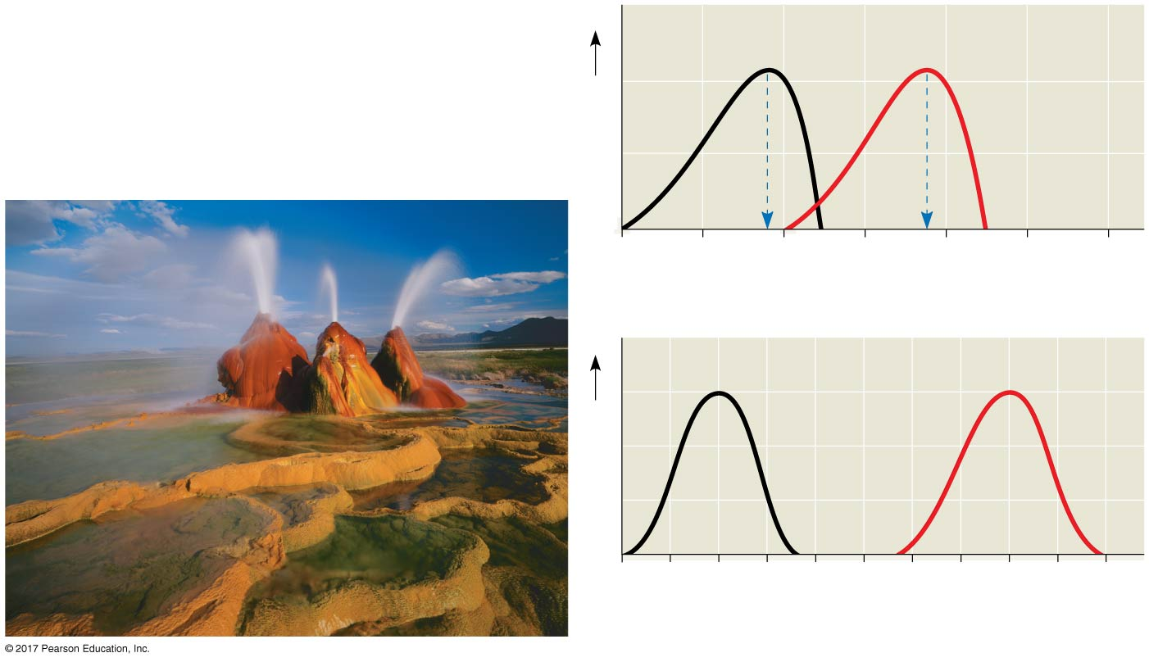
Figure 6.17
Environmental factors affecting enzyme activity
Optimal temperature for
typical human enzyme (37ºC)
Optimal temperature for
enzyme of thermophilic
(heat-loving)
bacteria (75ºC)
Rate of reaction
0
20
40
60
80
100
120
Temperature (ºC)
(a) Optimal temperature for two enzymes
Pepsin (stomach
enzyme)
Trypsin (intestinal
enzyme)
Rate of reaction
0
1
2
3
4
5
6
7
8
9
10
pH
(b) Optimal pH for two enzymes
© 2018 Pearson Education Ltd.
Notes:
Figure 6.17 Environmental factors affecting enzyme activity

Slide 60
Cofactors
Cofactors(輔因子)are nonprotein enzyme helpers
Cofactors may be inorganic (such as a metal in ionic form) or organic
An organic cofactor is called a coenzyme輔酶
Coenzymes include vitamins

Slide 61
Enzyme Inhibitors
Competitive inhibitors競爭性抑制劑bind to the active site of an enzyme, competing with the substrate
Noncompetitive inhibitors bind to another part of an enzyme, causing the enzyme to change shape and making the active site less effective
Some examples of inhibitors are toxins, poisons, pesticides, and antibiotics

Slide 62
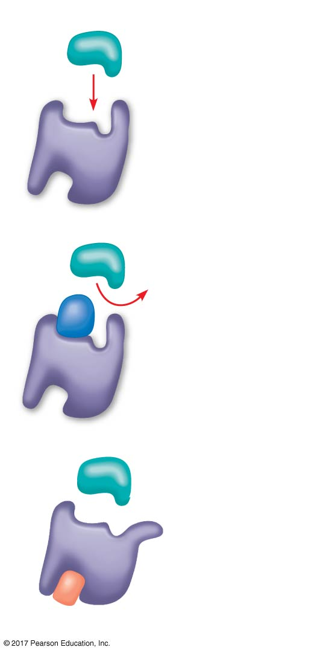
Figure 6.18
(a) Normal binding
Inhibition of enzyme activity
Substrate
Active site
Enzyme
(b) Competitive inhibition
Competitive
inhibitor
(c) Noncompetitive inhibition
Noncompetitive inhibitor
© 2018 Pearson Education Ltd.
Notes:
Figure 6.18 Inhibition of enzyme activity

Slide 63
The Evolution of Enzymes
Enzymes are proteins encoded by genes
Changes (mutations) in genes lead to changes in amino acid composition of an enzyme
Altered amino acids, particularly at the active site, can result in novel enzyme activity or altered substrate specificity

Slide 64
Under environmental conditions where the new function is beneficial, natural selection would favor the mutated allele
For example, repeated mutation and selection on the β-galactosidase enzyme in E. coli resulted in a change of sugar substrate under lab conditions
(changed into an enzyme specialized for breaking down a sugar other than its original one)

Slide 65
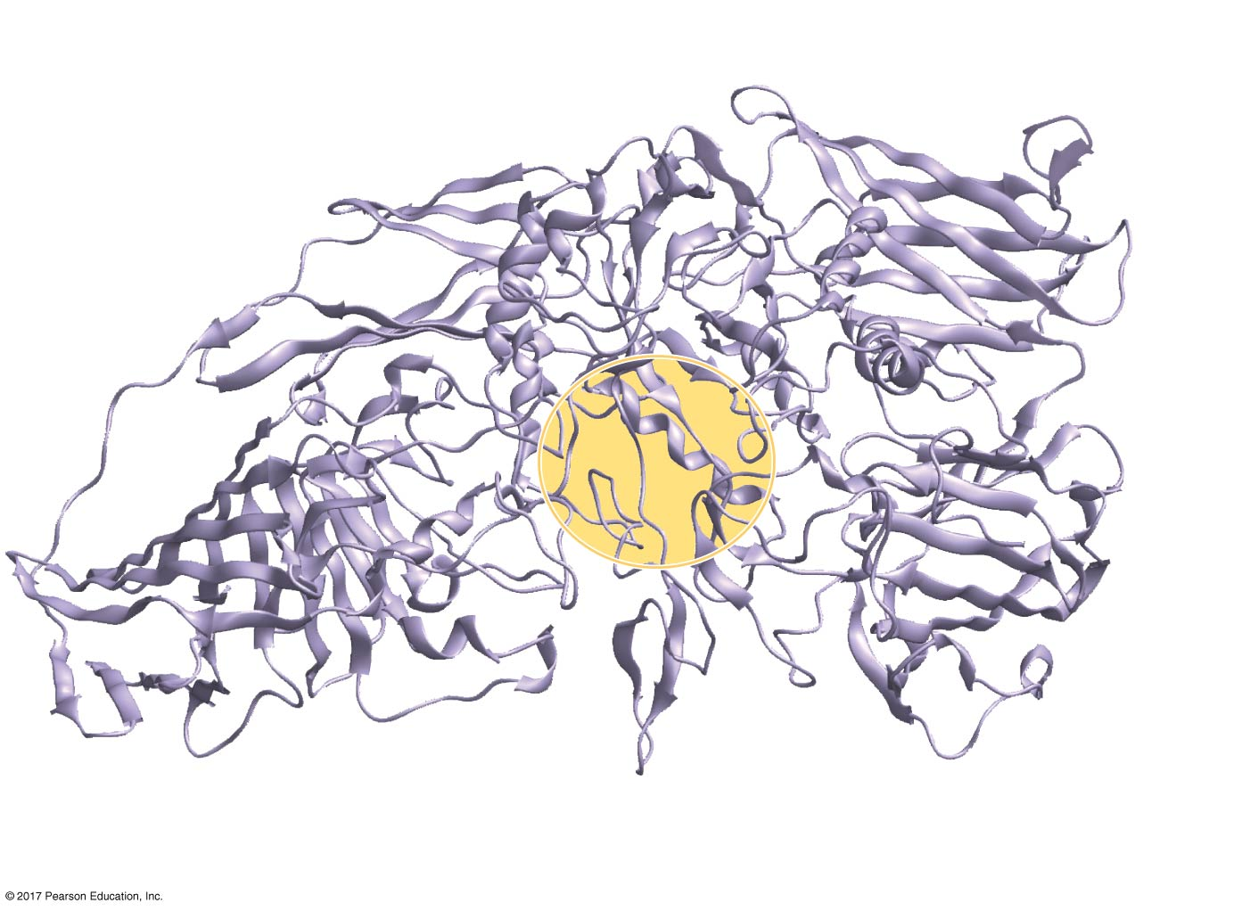
Figure 6.19
Mimicking evolution of an enzyme with a new function
Two changed amino acids were
found near the active site.
Active site
Two changed amino acids
were found in the active site.
Two changed amino acids
were found on the surface.
© 2018 Pearson Education Ltd.
Notes:
Figure 6.19 Mimicking evolution of an enzyme with a new function

Slide 66
Concept 6.5: Regulation of enzyme activity helps control metabolism
Chemical chaos would result if a cell’s metabolic pathways were not tightly regulated
A cell does this by switching on or off the genes that encode specific enzymes or by regulating the activity of enzymes

Slide 67
Allosteric Regulation of Enzymes
Allosteric regulation異位調節may either inhibit or stimulate an enzyme’s activity
Allosteric regulation occurs when a regulatory molecule binds to a protein at one site and affects the protein’s function at another site這個 enzmye 在受質 另一個區域 又有 "另一個受質區" 而這個受質區 是因為 產物 如果 過剩 or 過少 會 負回饋 or 正回饋到 "另一個受質區"

Slide 68
Allosteric Activation and Inhibition
Most allosterically regulated enzymes are made from polypeptide subunits, each with its own active site
The enzyme complex has active and inactive forms
The binding of an activator stabilizes the active form of the enzyme
The binding of an inhibitor stabilizes the inactive form of the enzyme

Slide 69
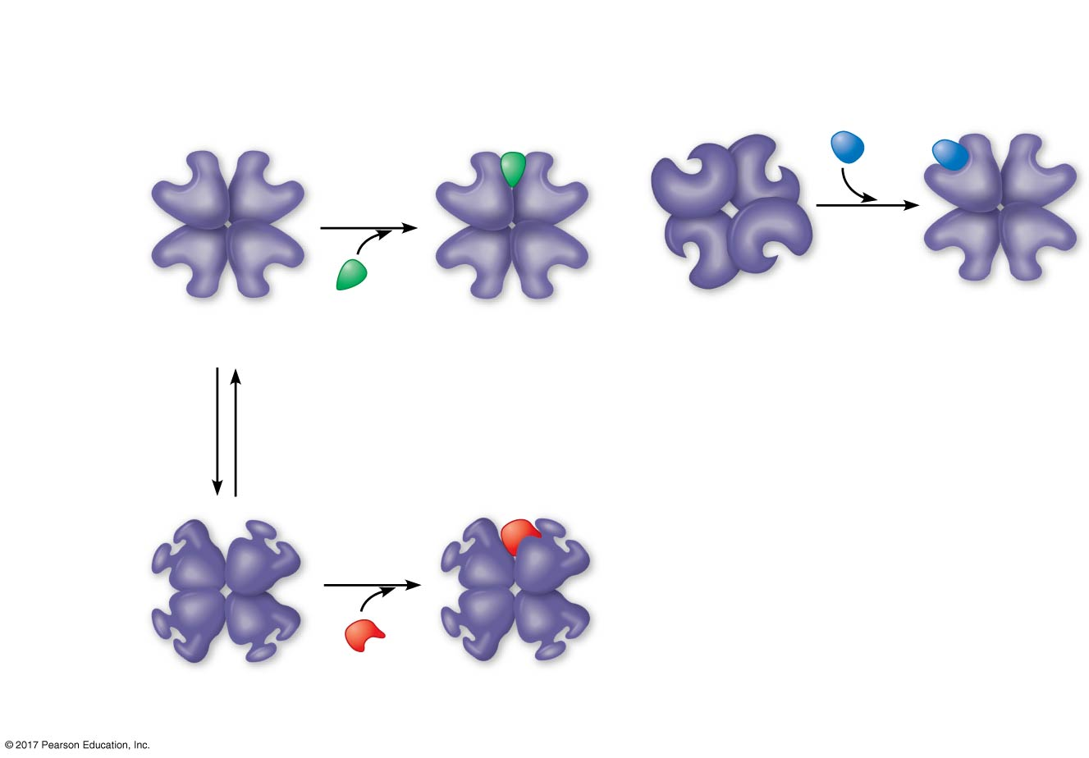
Figure 6.20a
Allosteric regulation of enzyme activity
(a) Allosteric activators and inhibitors
Allosteric
enzyme
with four
subunits
Active site
(one of four)
Regulatory
site (one
of four)
Activator
Active form
Stabilized
active form
Oscillation
Non-
functional
active site
Inhibitor
Inactive form
Stabilized
inactive form
© 2018 Pearson Education Ltd.
Notes:
Figure 6.20a Allosteric regulation of enzyme activity

Slide 70
Cooperativity is a form of allosteric regulation that can amplify enzyme activity
One substrate molecule primes an enzyme to act on additional substrate molecules more readily
Cooperativity is allosteric because binding by a substrate to one active site affects catalysis in a different active site

Slide 71
Figure 6.20b
Allosteric regulation of enzyme activity
(b) Cooperativity: another type of allosteric activation
Substrate
Inactive form
Stabilized
active form
Notes:
Figure 6.20b Allosteric regulation of enzyme activity

Slide 72
Feedback Inhibition
In feedback inhibition反饋機制, the end product of a metabolic pathway shuts down the pathway
Feedback inhibition prevents a cell from wasting chemical resources by synthesizing more product than is needed

Slide 73
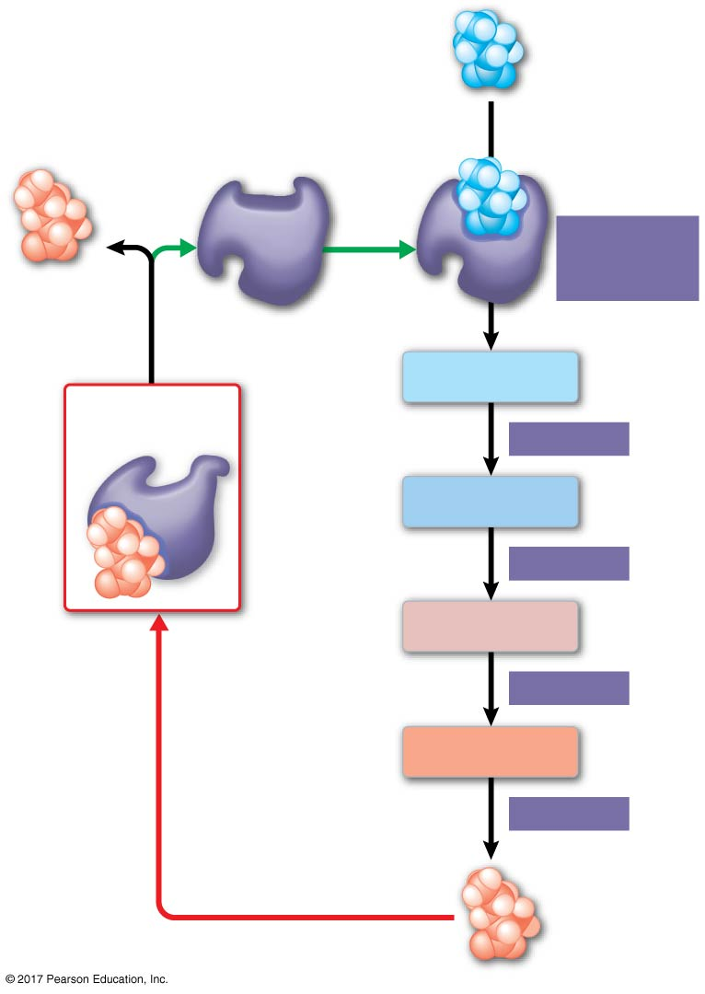
Figure 6.21
Feedback inhibition in isoleucine synthesis
Initial
substrate
(threonine)
Active site
available
Threonine
in active site
Enzyme 1
(threonine
deaminase)
Isoleucine
used up by
cell
Intermediate A
Feedback
inhibition
Active site
no longer
available;
pathway is
halted
Enzyme 2
Intermediate B
Enzyme 3
Isoleucine
binds to
allosteric
site.
Intermediate C
Enzyme 4
Intermediate D
Enzyme 5
End product
(isoleucine)
© 2018 Pearson Education Ltd.
Notes:
Figure 6.21 Feedback inhibition in isoleucine synthesis

Slide 74
Localization of Enzymes Within the Cell
Structures within the cell help bring order to metabolic pathways
Some enzymes act as structural components of membranes
In eukaryotic cells, some enzymes reside in specific organelles; for example, enzymes for cellular respiration are located in mitochondria

Slide 75
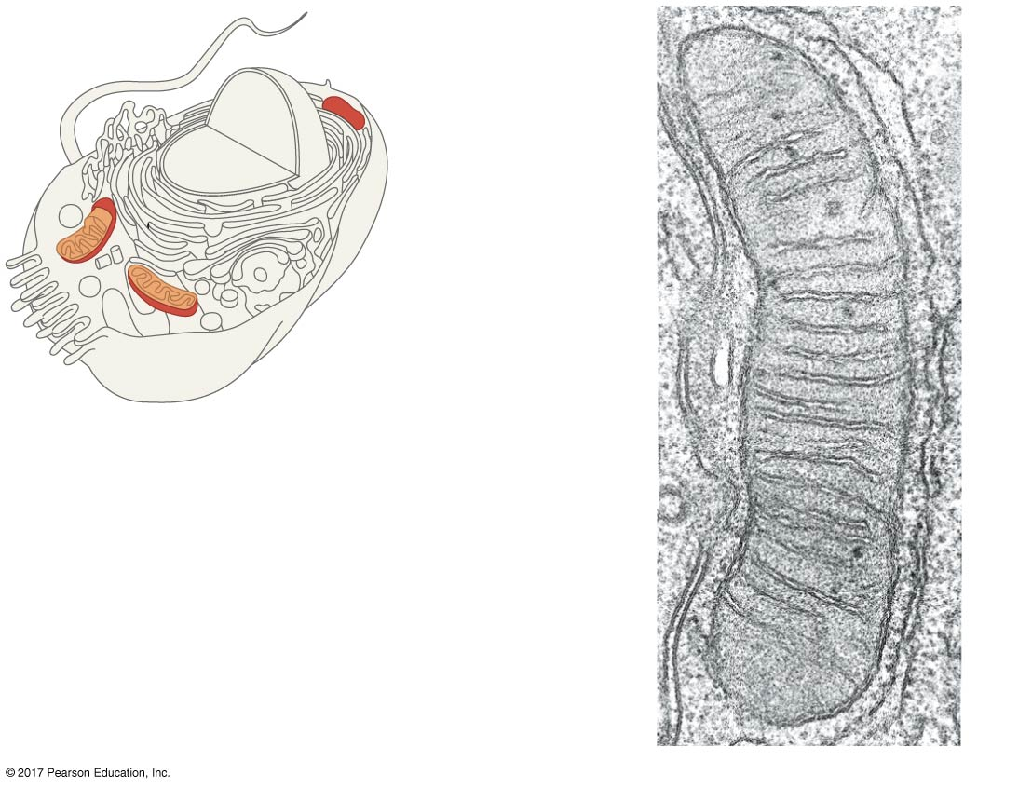
Figure 6.22
Organelles and structural order in metabolism
Mitochondrion
The matrix contains
enzymes in solution that
are involved in the second
stage of cellular respiration.
Enzymes for the third
stage of cellular
respiration are
embedded in the
inner membrane.
1 µm
© 2018 Pearson Education Ltd.
Notes:
Figure 6.22 Organelles and structural order in metabolism

